Slide 1
Data Security with NVMe over Fabric Technology

Slide 2
Student Names
1. Ashu Goyal - 18BIT0168
2. Shaifali Choudhary - 18BCE2242
3. Rashmitha Challa - 18BCE7273
4. Abhimanyu Atri - 18BCE2192
College Mentor HPE Mentors
Dr. Sureshkumar N. BL Chetan
AK Rajesh

Slide 3
GOALS
1. Understand evolving trends with NVMe over Fabric (NVMe-oF) and analyze potential vulnerability points in transport and data at rest.
2. What are the current challenges with NVMe over Fabric technology?
3. What are the vulnerability points with existing NVMeOF reference implementations of initiator and targets?
4. What is the viewpoint of data at rest security from the specification perspective?
5. How NVMe-oF can enable Storage as a service in the cloud?
6. What are the aspects covering security vs. performance for reference implementations?

Slide 4
TIMELINE
Understanding of storage concepts and protocols.
NVMe commands and Security related aspects in spec.
Install Initiator/target on Linux system and do IOs.
2 Weeks
1 Week
1 Week
2 Weeks
1 Week
NVMe architecture and commands.
Network security for NVMeOF – read about vulnerabilities in Ethernet that can impact.
Read about error handling and recovery in NVMe and NVMeOF.

Slide 5
MILESTONES
Network security for NVMeOF – read about vulnerabilities in Ethernet that can impact.
Network Security/Data Security - Authentication
Understand Storage array, NVMe and NVMe-OF protocol, Data security.
1
3
5
2
4
6
NVMe commands and Security related aspects in spec.
Install Initiator/target on Linux system and do IOs.
Read about error handling and recovery in NVMe and NVMeOF.

Slide 6
MILESTONE 1
1
Understand Storage array, NVMe and NVMe-OF protocol, Data security.

Slide 7
What Is a STORAGE ARRAY?
Definition - A storage array, also called a disk array, is a data storage system for block-based storage, file-based storage, or object storage.
Rather than storing data on a server, storage arrays use multiple drives in a collection capable of storing a huge amount of data, managed by a central management system. The drives on which data is stored are usually spinning hard disk drives (HDDs) or solid-state drives (SSDs).

Slide 8
How Do Storage Arrays WORK?
Storage arrays keep storage separate from servers using a collection of hard disk drives (HDDs) or solid-state drives (SSDs). In some cases, they use a combination of both so they can scale much more efficiently than the storage capacity of a collection of servers.
● HDD storage arrays- HDD storage arrays, or disk arrays, are commonly used in business environments for storage purposes and have excellent redundancy features to help protect data. For example, Redundant Arrays of Independent Disks (RAID) controllers are used to make copies of the same data across multiple hard disks. This protects the data from loss if one of the disks fails, as all the backup copies are still available.
● SSD storage array- An SSD storage array, also called a flash storage array, has the same basic storage array architecture as an HDD array but will operate much faster. However, HDDs are cheaper, so they’re sometimes used in combination.

Slide 9
APPLICATION of Storage Arrays
Storage arrays form key components of storage networks, such as Storage Area Networks (SANs) for block storage and Network-Attached Storage (NAS) for file storage. These networks enable storage to be managed separately from the local area network (LAN) or wide area network (WAN) that connects other devices inside an organization.
Types of Storage Arrays:
Storage Area Networks (SANs) arrays
Network-attached storage(NAS)

Slide 10
TYPES of Storage Arrays(Cont.d)
1. Storage Area Networks (SANs) arrays: A Storage Area Network (SAN) or Storage Network is a computer network which provides access to consolidated, block-level data storage. SANs are primarily used to access data storage devices, such as storage arrays and tape libraries from servers so that the devices appear to the operating system as direct-attached storage. A SAN typically is a dedicated network of storage devices not accessible through the local area network (LAN).
2. Network-attached storage(NAS): Network-attached storage(NAS) is a file-level (as opposed to block-level storage) computer data storage server connected to a computer network providing data access to a heterogeneous group of clients. NAS is specialized for serving files either by its hardware, software, or configuration.

Slide 11
Network-attached storage(NAS) VS Storage Area Networks(SAN)
NAS(Network-attached storage)
File level data
Primary media: Ethernet
I/O Protocol: NFC/CIFS
NAS appear to OS as a shared folder
Inexpensive
Dependent on the LAN
Requires no architectural changes
SAN(Storage Area Network)
Block level data
Primary media: Fiber channel
I/O Protocol: SCSI
SAN appear to OS as attached storage
Expensive
Independent on the LAN
Requires architectural changes

Slide 12
What is NVMe?
NVMe (nonvolatile memory express) is a new storage access and transport protocol for flash and next-generation solid-state drives (SSDs) that delivers the highest throughput and fastest response times yet for all types of enterprise workloads.
Today, in both purchaser applications and business, clients expect ever-quicker reaction times, even as the actual applications become inconceivably more unpredictable and resource dependent.
NVMe protocol accesses flash storage via a PCI Express (Peripheral Component Interconnect Express) bus, which supports tens of thousands of parallel command queues and thus is much faster than hard disks and traditional all-flash architectures, which are limited to a single command queue.

Slide 13
Why NVMe?
It’s about time – NVMe storage is big news in the enterprise data center because it saves time :
Dissimilar to conventions planned in the times of mechanical hard disk drives, NVMe use solid state storage, yet in addition the present multicore CPUs and gigabytes of memory.
NVMe delivers faster access and consumes less power, thus reducing total cost of ownership (TCO) for enterprises and extending battery life for mobile clients. Compared with other interfaces designed for mechanical storage devices, NVMe reduces latency, and delivers higher Input/Output per Second (IOPS). NVMe also offers performance across multiple cores for quick access to critical data, scalability for current and future performance, and support for standard security protocols

Slide 14
NVMe Use Cases
Real-time customer interactions such as finance, e-commerce, and software sales agents.
Artificial intelligence (AI), machine learning (ML), big data, and advanced analytics apps.
DevOps, enabling you to run more iterations in less time.

Slide 15
NVMe PERFORMANCE COMPARISON with others in the market!
Serial ATA (SATA™), with its 3rd generation 6 Gb/s bandwidth, is currently the most widely used interface for hard disk drives (HDDs). Advanced Host Controller Interface (AHCI), the technical standard that specifies the operation of SATA host bus adapters, was designed to connect the CPU/memory subsystem with much slower rotating media-based storage. This renders the AHCI inefficient for the much faster SSDs, which behave more like DRAM than spinning media.
In random workloads, NVMe delivers 2X the performance of SAS 12 Gb/s, and 4-6X of SATA 6 Gb/s.
For sequential workloads, NVMe delivers 2X the performance of SAS 12 Gb/s, and 4X of SATA 6 Gb/s.

Slide 16
HDD vs SATA vs NVMe
Maximum Theoretical Speed
Sequential Read
Sequential Write
2500
1000
550 550
150
130
2500
2000
1500
1000
500
0
HDD SATA NVMe

Slide 17
What is NVMe over Fabric ?
The best thing about NVMe using PCIe is that it is very fast. But the only drawback is that it is contained inside of a single computer.
NVMe over Fabrics (NVMe-oF) is an extension of the NVMe network protocol specification designed to connect hosts to storage across a network fabric using the NVMe protocol.
It is designed to enable data transfers between a host computer and a target storage device or system over a network. Data can be transferred through methods such as Ethernet, Fibre Channel (FC) or InfiniBand.

Slide 18
Need of NVMe over Fabric Technology.
NVM Express over Fabrics defines a common architecture that supports a range of storage networking fabrics for NVMe block storage protocol over a storage networking fabric.
This includes enabling a front-side interface into storage systems, scaling out to large numbers of NVMe devices and extending the distance within a datacenter over which NVMe devices and NVMe subsystems can be accessed.

Slide 19
What makes NMVe over Fabrics very efficient?
Reliable, credit-based flow control and delivery mechanisms:This type of flow control allows the network or fabric to be self-throttling, providing a reliable connection that can guarantee delivery at the hardware level without the need to drop frames or packets due to congestion.
An NVMe-optimized client:The client software should be able to send and receive native NVMe commands directly to and from the fabric without having to use a translation layer such as SCSI.
A low-latency fabric :The fabric itself should be optimized for low latency. The fabric should impose no more than 10 µs of latency end-to-end, including the switches

Slide 20
What makes NMVe over Fabrics very efficient?(Cont.d)
Multi-Host support: The fabric should be able to support multiple hosts actively sending and receiving commands at the same time. This also applies to multiple storage subsystems.
Multi-port support: The host servers and the storage systems should be able to support multiple ports simultaneously.
Multi-path support: The fabric should be able to support multiple paths simultaneously between any NVMe host initiator and any NVMe storage target.

Slide 21
Milestone 2
2
NVMe Architecture, Commands and Security related aspects in spec.

Slide 22
NVMe Architecture
NVMe upholds 64K orders per line and up to 64K lines. These lines are planned to such an extent that I/O orders and reactions to those orders work on a similar processor center and can exploit the equal preparing abilities of multi-center processors. Every application or string can have its own autonomous line, so no I/O locking is required. NVMe likewise upholds MSI-X and intrude on guiding, which forestalls bottlenecking at the CPU level and empowers gigantic adaptability as frameworks extend.

Slide 23
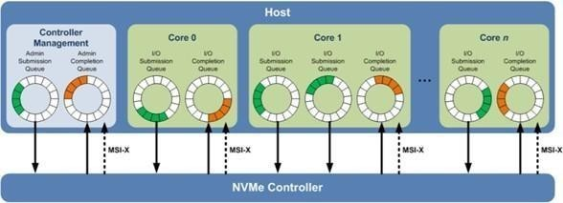
NVMe Architecture

Slide 24
NVMe Commands
ADMIN Commands
Create I/O Submission Queue
Delete I/O Submission Queue
Create I/O Completion Queue
Delete I/O Completion Queue
Get Log Page
Identify
Abort
Set Features
Get Features
NVM I/O Commands
Read
Write
Flush
Write Uncorrectable
Compare
Dataset Management
Write Zeros
Reservation Register
Reservation Report
Reservation Acquire
Reservation Release

Slide 25
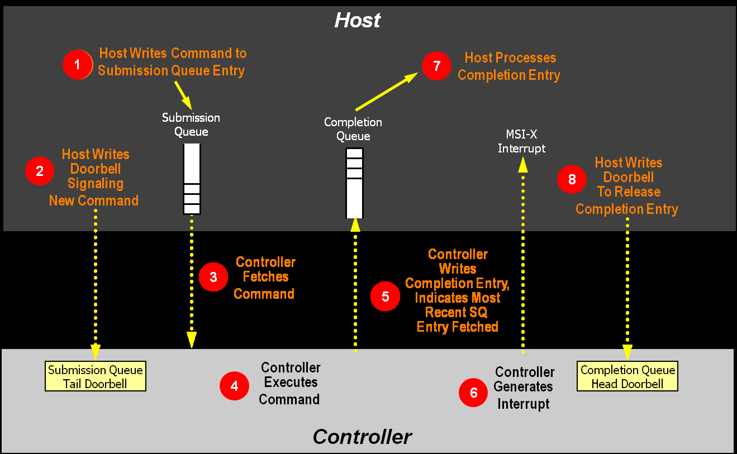
Controller Architecture
Communication between Host and the Controller.

Slide 26
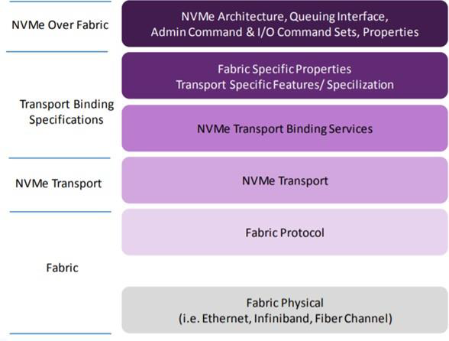
Architecture of NVMe-OF

Slide 27
Security related aspects in spec.
Data Security Considerations:
Data in Flight: Network security (especially applicable for shared infrastructure)
Data at Rest: Against theft of data or keys, and ransomware (esp. SSD media and key encryption with SED)
HW Root of Trust: Dedicated security engine to ensure Secure Boot, Secure FW, and Key Management across all peripherals

Slide 28
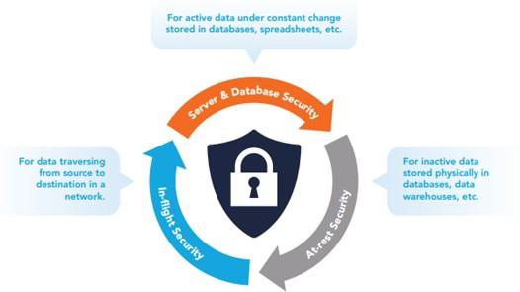
Security related aspects in spec.(Cont.d)

Slide 29
Milestone 3
3
Network security for NVMeOF – read about vulnerabilities in Ethernet that can impact.

Slide 30
Vulnerabilities in Ethernet
We sometimes focus more on the wireless side of the network when it comes to security because Wi-Fi has no physical fences. After all, a hacker can detect your SSID and launch an attack from outside the organisation using a remote connection without any physical access.
But in a world of insider threats, targeted attacks from outside, as well as hackers who use social engineering to gain physical access to corporate networks, the security of the wired portion of the network should also be of great concern.

Slide 31
Most common network security threats over Ethernet
Computer virus: Computer viruses are pieces of software that are designed to be spread from one computer to another. They’re often sent as email attachments or downloaded from specific websites with the intent to infect your computer and other computers on your network by using systems on your network. Viruses are known to send spam, disable your security settings, corrupt and steal data from your computer including information such as passwords, even going as far as to delete everything on your hard drive or SSDs. This is also a threat for NVMes because once a virus enters into any of the devices connected through NVMe, it would be very hard to stop it from spreading to other devices because the data is continuously being transferred and the virus will infect the whole NVMe network.

Slide 32
Most common network security threats over Ethernet(Cont.d)
2.Trojan horse: Metaphorically, a “Trojan horse” refers to tricking someone into inviting an attacker into a securely protected area. In computing, it holds a very similar meaning — a Trojan horse, or “Trojan,” is a malicious bit of attacking code or software that tricks users into running it willingly, by hiding behind a legitimate program.
They spread often by email; it may appear as an email from someone you know, and when you click on the email and its included attachment, you’ve immediately downloaded malware to your computer. Trojans also spread when you click on a false advertisement.
Once inside your computer, a Trojan horse can record your passwords by logging keystrokes, hijacking your webcam, and stealing any sensitive data you may have on your computer.

Slide 33
Most common network security threats over Ethernet(Cont.d)
3. DOS and DDOS attack:
A DoS attack is performed by one machine and its internet connection, by flooding a website with packets and making it impossible for legitimate users to access the content of flooded website. Fortunately, you can’t really overload a server with a single other server or a PC anymore. In the past years it hasn’t been that common if anything, then by flaws in the protocol.
A DDoS attack, or distributed denial-of-service attack, is similar to DoS, but is more forceful. It’s harder to overcome a DDoS attack. It’s launched from several computers, and the number of computers involved can range from just a couple of them to thousands or even more. Since the attack comes from so many different IP addresses simultaneously, a DDoS attack is much more difficult for the victim to locate and defend against.
In a NVMe network where many devices are connected and transferring a large amount of data, Dos and DDos attacks can act as an interrupt, which will compromise the data transfer.

Slide 34
Most common network security threats over Ethernet(Cont.d)
4. SQL Injection attack
Today many servers storing data for websites use SQL. As technology has progressed, network security threats have advanced, leading us to the threat of SQL injection attacks. SQL injection attacks are designed to target data-driven applications by exploiting security vulnerabilities in the application’s software. They use malicious code to obtain private data, change and even destroy that data, and can go as far as to void transactions on websites. It has quickly become one of the most dangerous privacy issues for data confidentiality.

Slide 35
Milestone 4
4
Network Security/Data Security - Authentication

Slide 36
Ways to improve wired network security
Perform auditing and mapping: Auditing and mapping of networks must be done regularly. A clear understanding of the entire network’s infrastructure, for instance the vendor/model, location, and basic configuration of firewalls, routers, switches, Ethernet cabling and ports, and wireless access points. Plus know exactly what servers, computers, printers, and any other devices are connected, where they are connected, and their connectivity path throughout the network.
During auditing and mapping the auditor might find specific security vulnerabilities or ways in which security, performance and reliability can be increased. Or maybe during the audit the auditor run across an incorrectly configured firewall or maybe physical security threats.

Slide 37
Ways to improve wired network security(Cont.d)
2. Keep the network up-to-date: Once you have a basic network audit and map complete, consider diving deeper. Check for firmware or software updates on all network infrastructure components. Login to the components to ensure default passwords have been changed, review the settings for any insecure configuration, and look into any other security features or functionality you currently aren’t using.

Slide 38
Ways to improve wired network security(Cont.d)
3. Physically secure the network: The physical security of the network can be just as crucial as say your Internet facing firewall. Just as you need to protect against hackers, bots and viruses, you need to protect against local threats, too. Without strong physical security of your building and network, a nearby hacker or even an employee could take advantage of it. For instance, maybe they plug a wireless router into an open Ethernet port, giving them and anyone else nearby wireless access to your network. But if that Ethernet port wasn’t visible or at least disconnected, then that wouldn’t have happened. Some steps which can be taken to ensure physical security are:
Ensure you have a good building security plan in place to try and prevent outsiders from entering.
Ensure all wiring closets and/or other places where the network infrastructure components are placed have been physically secured from both the public and employees. Use door and cabinet locks.

Slide 39
Ways to improve wired network security(Cont.d)
Verify that Ethernet cabling is run out of sight and isn’t easily accessible; the same with wireless access points.
Disconnect unused Ethernet ports, physically or via switch/router configuration, especially those in the public areas of the building.
4. Consider MAC address filtering: One major security issue of the wired side of the network is the lack of a quick and easy authentication and/or encryption method; people can just plug in and use the network. On the wireless side you have at least WPA2-Personal (PSK) that’s easy to deploy.
Although MAC address filtering can be bypassed by a determined hacker, it can serve as the first layer of security. It won’t completely stop a hacker, but it can help you prevent an employee, for instance, from causing a potentially serious security hole, like allowing a guest to plug into the private network. It can also give you more control over which devices are on the network. But don’t let it give you a false sense of security, and the approved MAC address list must always be up-to-date.

Slide 40
Milestone 5
5
Error handling and recovery in NVMe and NVMeOF.

Slide 41
Error Handling in NVMe and NVMeOF
NVMe technology was built from the ground up for SSDs, and the original NVMe specification included a standard SMART
(Self-Monitoring, Analysis and Reporting Technology) log that
monitored errors, device health, and endurance. At the time, SAS/SATA drives had SMART capability, but it was vendor specific (tools had to parse data by vendor) and the data wasn’t widely trusted.
Features like enhanced error reporting, logging, management, debug, and telemetry are also added in NVMe technology after standard SMART logs. With the help of these features the customers have a smooth and normal operation of their SSD and are able to understand where and why things are failing and when it does happen.

Slide 42
Reasons for errors in NVMes:
1. System incompatibility– In this situation, there is nothing wrong with the SSD, but compatibility bugs are preventing normal operation. An example would be a system hang or no enumeration of the SSD. A customer would generally return an SSD to the manufacturer if this happened.
2. SSD Endurance– SSD endurance is finite and writing data will eventually wear out an SSD. Good news is that this can be accurately predicted and modeled by understanding the workload and the SSD, and NVMe technology can report the statistics to monitor this in real time.

Slide 43
Reasons for errors in NVMes:(Cont.d)
3. Firmware errors– SSD firmware is complex and must handle many corner cases of workloads and states for transferring data. SSD vendors try to eliminate as many firmware issues as possible prior to going to production, but perfect validation and verification can’t catch all firmware issues. Firmware failures account for the majority of SSD failures!
4. Media Errors– there are many different classes of SSDs, some with end-to-end data protection, power loss protection, and redundancy within the SSD media through RAID, XOR, or other technologies. But NAND flash and other storage and memory classes do have failures, and too many will cause the SSD to stop functioning
5. Hardware errors– capacitors, resistors, and power management circuits can fail. These are rarer but are more catastrophic when they do happen.

Slide 44
Features of the mentioned tools which helps in smooth handling in case of these errors:
1. Management tools, log pages, endurance monitoring can help identify and pinpoint when a device fails, the number of errors and type of errors. These errors could include hardware failure, integrity errors, media errors, temperature issues and more.
Log Pages
Log Pages are maintained in the SSD and can be read by host software at any time. Below are the various log pages NVMe technology utilizes:

Slide 45
Features of the mentioned tools which helps in smooth handling in case of these errors:(Cont.d)
2. Error Log Page: The Error Log Pages are used to log all errors so that no errors go unreported or missing. NVMe drives maintain an error log page that records all errors that happen. This log page maintains important information regarding the number of errors, which queue they came from, and which data and namespaces were affected. This is critical in identifying problematic drives and roots causing what in the system may be causing errors.

Slide 46
Features of the mentioned tools which helps in smooth handling in case of these errors:(Cont.d)
3. SMART Log Page: The SMART log page is used to report on general health information about the drive. Its main health indicator is called the critical warning, which warns of a problem in the drive. The NVMe drive will then inform the host on the type of issue. Issues could mean the drive is in a degraded or read only mode due to media errors, the drive is currently exceeding the temperature threshold or there could be a hardware failure. The SMART log page also works to summarize the error log page for media or data integrity errors and lists the number of unsafe shutdowns caused by power loss events.

